Slide 1

ALZHEIMER’S DISEASE DETECTION
USING NEURAL NETWORKS
Project Associates | Project Guide
20P31A1252 S. VIJAY MANIKANTA REDDY | Mrs. J. Sailaja., M.Tech
20P31A1210 CH. VANDANA DEVI
20P31A1236 N. NARASIMHA NAIDU
20P31A1209 CH. SAI SURYA
Department of Information Technology
Aditya College of Engineering & Technology (A)

Slide 2
Abstract
This project presents an overview of the application of deep learning in Alzheimers disease detection, highlighting the key steps involved, including data collection, preprocessing, model selection, training, and deployment.
Our technology has grown to such an extent that a machine is capable enough to predict the Alzheimers disease by merely looking at a high definition image of MRI Images at its early stage itself.
Magnetic resonance imaging (MRI) pictures are the most acceptable manner or method for representing the human brain for identifying Alzheimers Disease.
Our proposed system aims to develop sophisticated system for early detection of Alzheimers Disease in medical imaging by using Convolutional Neural Network (CNN) algorithm.

Slide 3
Problem Statement
Identification of Alzheimer’s Disease: Alzheimer's disease presents a significant public health challenge, characterized by cognitive decline and memory loss, necessitating accurate and timely diagnosis to initiate interventions and improve patient outcomes.
Early Detection and Intervention: Leveraging CNNs on MRI scan data to identify subtle neurological changes indicative of Alzheimer's disease at its earliest stages.
Classification of Disease Severity: The research aims to classify the severity level of Alzheimer's disease into four categories: mild, non-demented, very mild demented, and moderate demented. This classification will provide valuable insights into disease progression and facilitate the development of tailored treatment strategies for patients at different stages of the disease.

Slide 4
Literature Survey
Researchers have proposed several techniques to accurately detect Alzheimer’s disease.
Further, many models using traditional methods have been proposed for disease Alzheimers Disease recognition, and used SVM and XGBoost techniques. [19][21]
Hence, CNNs are preferred for the replacement of traditional methods in recognizing Alzheimers disease as they achieve better outcomes. [20]
They have proposed Extreme Gradient Boosting (XGBoost) algorithm and achieved an accuracy of 81%. [21]
They have proposed Support Vector Machine and achieved an accuracy of 87.5%. [19]

Slide 5
Literature Survey
Author | Algorithm | Accuracy
Laboni Akter and Ferdib-Al-Islam | Extreme Gradient Boosting (XGBoost) algorithm | 81%
Hiroki Fuse | Support Vector Machine | 87%
Archana B | Convolutional Neural Network | 95% with 100 Epochs

Slide 6
Existing System
The Existing approach for detecting Alzheimers disease is using CNN.
The model is trained with 4400 images.
As per the research papers CNN was implemented on the Alzheimers dataset.
The Existing model achieved a high accuracy of 95% and they used 100 epochs on the Alzheimers Dataset to build the model.
Dataset: https://www.kaggle.com/datasets/marcopinamonti/alzheimer-mri-4-classes-dataset

Slide 7
Proposed System
The proposed system is to build the model Alzheimers disease detection using CNN.
To differentiate from the existing system we will focus on reducing the time complexity for CNN which initially uses 100 epochs on the Alzheimer Disease Dataset.
We reduced the number of epochs to 50 epochs and adjust the batch size according to the dataset and maintain accuracy similar to the existing approach.
With the help of techniques like fine tuning, early stopping we can improve the performance.

Slide 8
Functional requirements
Scalability: The model is designed to pre-process the data and deliver correct results varying with the scalable data.
Accuracy: The model uses deep learning algorithms for providing accurate results based on input data.
Performance: The model provides better performance for a given input image data.
Ease of Use: The system is simple, user friendly, graphics user interface implemented so any can use this system without any difficulties.
Portable: This project can deploy in every OS platform.

Slide 9
Non Functional requirements
Software Requirements:
Platform : Google Colab
Language Used : Python
Libraries : Keras over Tensorflow
Hardware Requirements:
Processor : i5
Installed memory (RAM) : 4 GB
Hard Disk : 150 GB
Operating System : Windows 10
Reliability: This system is used to make f1 scores, precision and recall for the extractive and abstractive summaries.
Performance: As it makes use of different models that help us to make the system high having performance output.

Slide 10
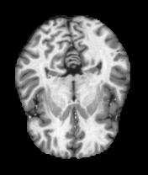
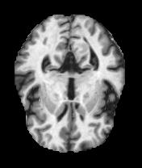
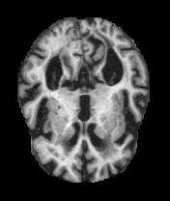
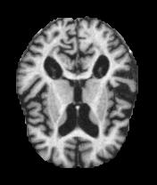
Dataset Description
Alzheimers Disease Dataset
This is a dataset Available in Kaggle, which consists of Four classes i.e., NonDemented, MildDemented, VeryMildDemented, ModerateDemented.
Size: It contains 4479 images
Access: https://www.kaggle.com/datasets/marcopinamonti/alzheimer-mri-4-classes-dataset
NonDemented VeryMildDemented MildDemented ModerateDemented
2240 images 1568 images 627 images 44 images

Slide 11
Methodology
Data Collection and Preprocessing: A dataset of MRI brain images, which includes four category of images. Preprocess the images by resizing them, normalizing pixel values, and augmenting the dataset to increase its diversity and robustness.
A Convolutional Neural Network (CNN) is a type of deep learning algorithm that is particularly well-suited for image recognition and processing tasks. It is made up of multiple layers, including convolutional layers, pooling layers, and fully connected layers.
Convolutional layers are essential in CNNs, applying filters to extract features from input images like edges and textures. The resulting feature maps undergo pooling layers, downsampling spatial dimensions while preserving crucial information. Finally, fully connected layers process pooled outputs to make predictions or classify images.

Slide 12
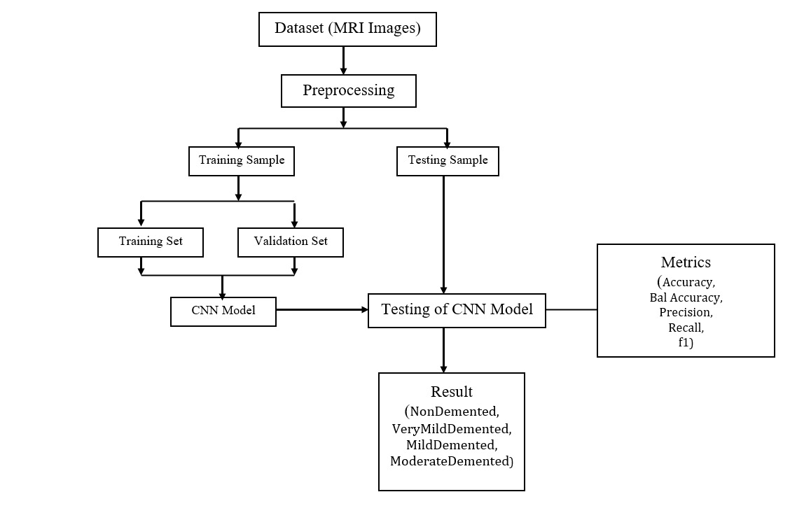
Methodology

Slide 13
Proposed CNN Architecture
INPUT IMAGE
176*208
PREPROCESSING
176*176
FLATTEN 2D-1D
6400
CONV2D
1*512
CONV2D
176*176*16
DROPOUT
5*5*256
CONV2D
1*128
MAX_POOLING2D
88*88*16
CONV2D
5*5*256
CONV2D
1*64
OUTPUT
(NonDemented,
VeryMildDemented,
MildDemented,
ModerateDemented)
CONV2D
44*44*32
DROPOUT
11*11*128
DENSE (SOFTMAX) 4
CONV2D
22*22*64
CONV2D
11*11*128

Slide 14
Procedure
Shuffled and divided the dataset into Training, Testing and Validation.
Used PIL, cv2 for resizing the images and converting the images into RGB under preprocessing.
Sequential method provided by Keras is used to add the layers
Firstly, the input layer is defined, as an image with size decided at the beginning of the code
Then, two 2D separable convolutions are added (always with elu activation function), before the Max Pooling 2D layer
Subsequently, three conv_block with increasing number of filters (32, 64, 128) are applied before a Dropout layer
Another conv_block (with 256 filters) is applied, then another Dropout and a Flatten layer
Three dense_block (512, 128, 64 units) and a Dense layer conclude the architecture of the model

Slide 15
Evaluation Measures
Accuracy: Measures proportion of correctly classified instances across all classes; calculated as total number of correct predictions divided by total number of instances.
Precision: Quantifies accuracy of positive predictions; calculated as true positives divided by sum of true positives and false positives.
Recall: Measures model's ability to correctly identify all instances of a particular class; calculated as true positives divided by sum of true positives and false negatives.
F1 Score: Harmonic mean of precision and recall, providing a balanced measure of model performance across all classes; calculated as 2 * (precision * recall) divided by sum of precision and recall.
Confusion Matrix: Tabular representation of model's predictions across all classes, summarizing true positives, true negatives, false positives, and false negatives for each class, offering insights into model's performance and areas for improvement

Slide 16
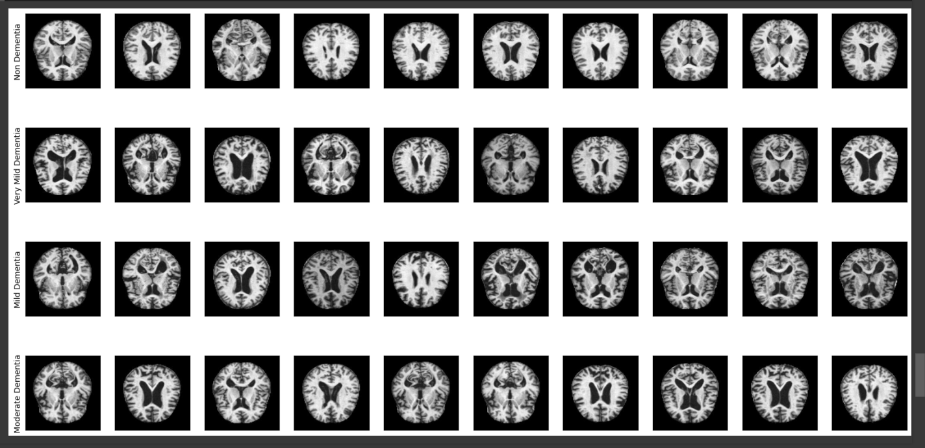
Results

Slide 17
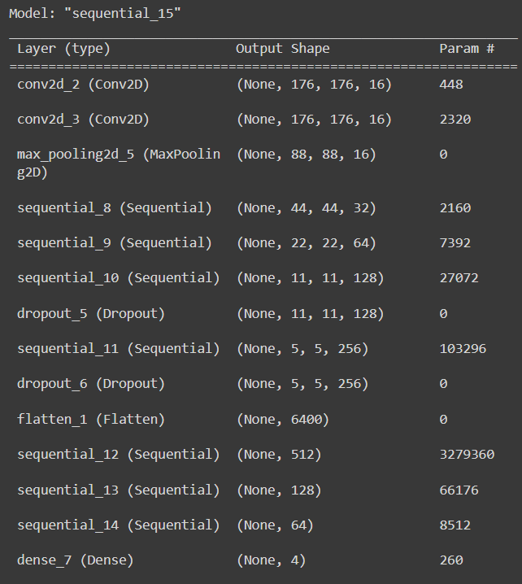
Results

Slide 18
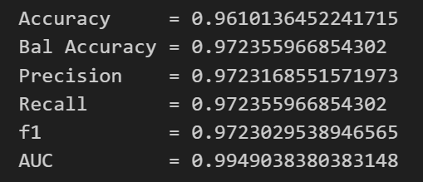
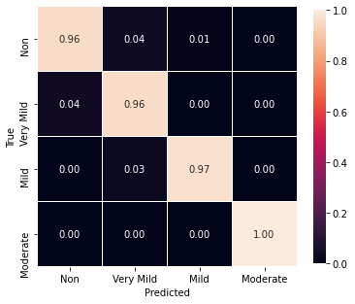
Results

Slide 19
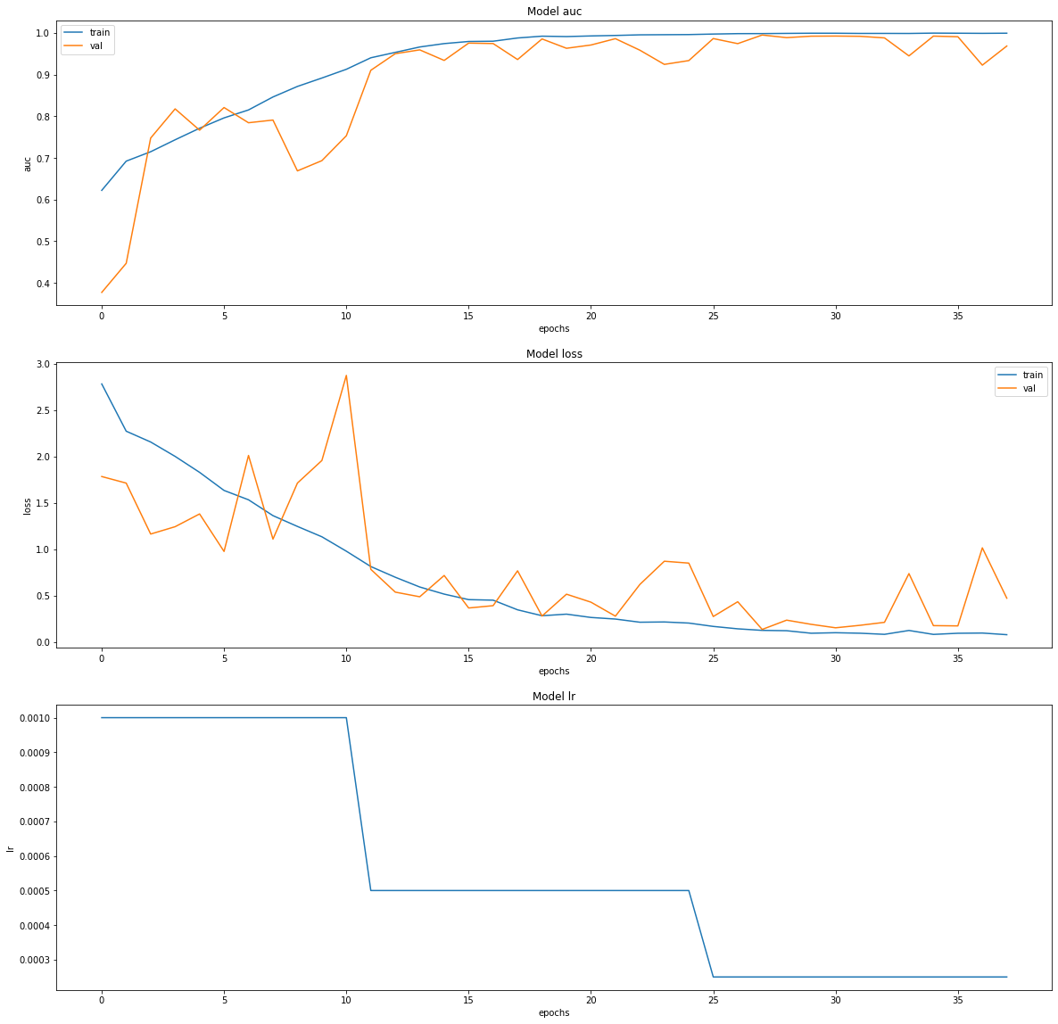
Results

Slide 20
Results

Slide 21
Results

Slide 22
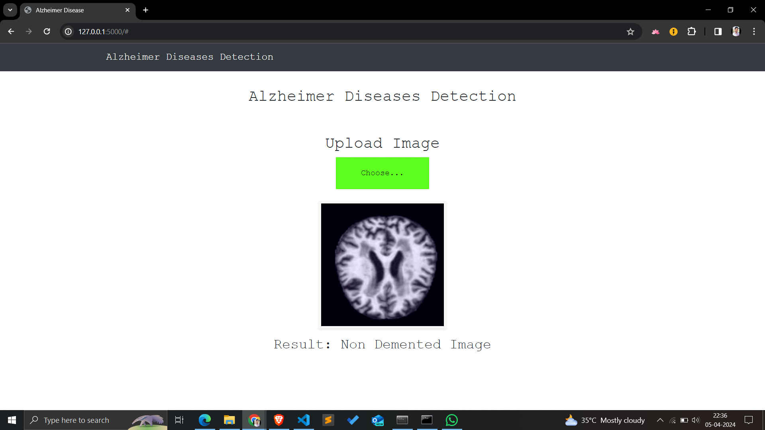
Results

Slide 23
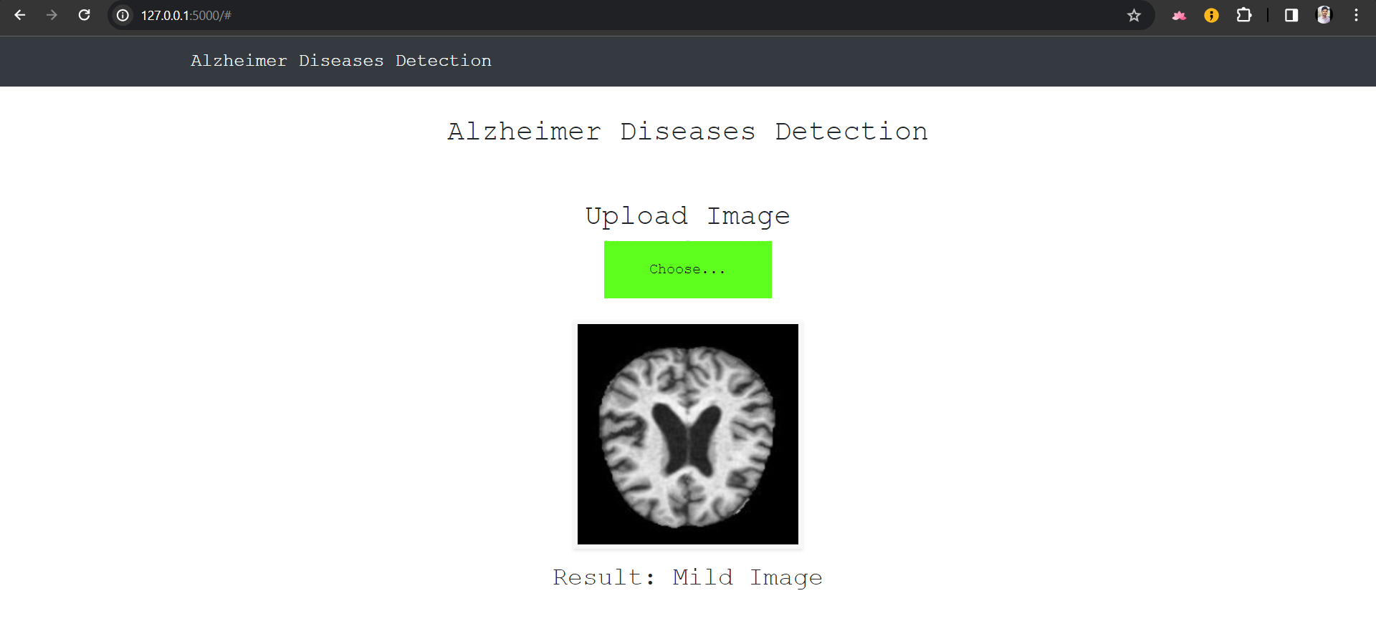
Results

Slide 24
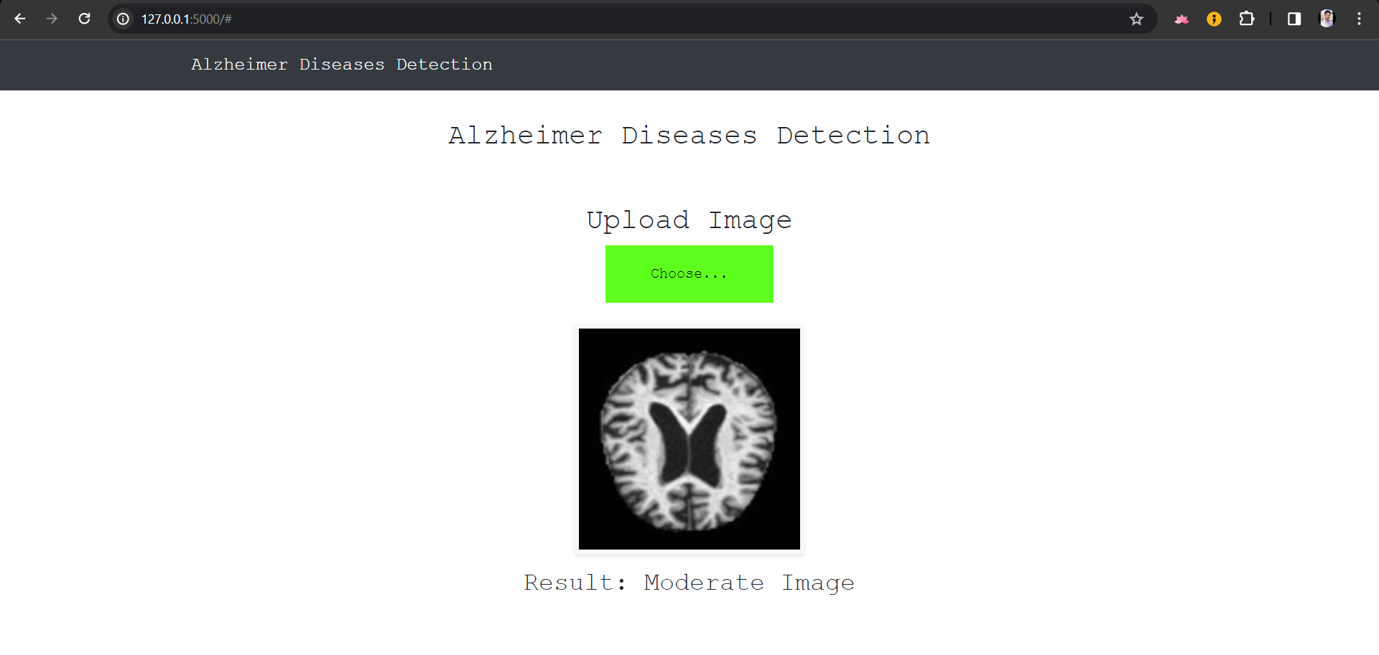
Results

Slide 25
Conclusion
The proposed CNN model demonstrated significant efficacy when tested with the validation data, showcasing a high accuracy rate of 96.1% and an Area Under the Curve (AUC) of 98%.
These impressive performance metrics underscore the model's capability to accurately classify Alzheimer's disease based on neuroimaging data.
Moreover, the model's ability to identify brain areas commonly associated with Alzheimer's disease holds promise for enhancing physicians' decision-making processes.
By leveraging the model's predictions, clinicians can gain valuable insights into each patient's AD severity level, thus aiding in the formulation of personalized treatment plans and interventions.

Slide 26
Future Scope
Dataset Expansion: Incorporating more diverse and extensive data sources to enrich the model's understanding and adaptability, including real-world patient data, genetic information, and emerging health trends.
Algorithm Refinement: Continual refinement of analysis algorithms, exploring advanced machine learning techniques like ensemble methods or neural networks to improve disease prediction and classification precision.
System Enhancement: Expanding the system's modules and features to encompass a wider range of diseases and health conditions, making it more comprehensive and versatile in predictive healthcare technology.

Slide 27
References
[1] Khan, Aunsia, et al. "Machine learning for Alzheimer's dementia prediction: A comprehensive survey." IEEE Access 9 (2021): 86249-86299.
[2] AL-Shoukry, Suhad, Tamer H. Rassem, and Nour Eldeen M. Khalifa. "Alzheimer's disease detection from functional magnetic resonance imaging using deep learning technique." Menoufia J. Electron. Eng. Res 29 (2020): 31-57.
[3] Ebrahim, Doaa, et al. "Convolutional neural network for early diagnosis of Alzheimer's disease." Advances in Bioinformatics 2020 (2020).
[4] Ju, Ronghui, et al. "Early diagnosis of Alzheimer's disease based on resting-state brain networks and deep learning." IEEE/ACM Transactions on Computational Biology and Bioinformatics 16.1 (2017): 244-257.

Slide 28
References
[5] Kruthika, K. R., et al. "Alzheimer's disease classification using hybrid principle component analysis and particle swarm optimization." Biocybernetics and Biomedical Engineering 38.4 (2018): 913-923.
[6] Akter, L., & Islam, F. A. (2021). Dementia Identification for Diagnosing Alzheimer's Disease using XGBoost Algorithm. 2021 International Conference on Information and Communication Technology for Sustainable Development (ICICT4SD), 205-209.
[7] Archana, B., & Kalirajan, K. (2023). Alzheimer's Disease Classification using Convolutional Neural Networks. 2023 International Conference on Innovative Data Communication Technologies and Application (ICIDCA), 1044-1048.
[8] Abhishek Raj & Sumit Bujare. Alzheimer’s Disease Recognition using CNN Model with EfficientNetV2.

Slide 29
References
[9] Saman Sarraf & Ghassem Tofighi. Deep Learning-based Pipeline to Recognize Alzheimer’s Disease using fMRI Data, 2016.
[10] Chen Fang , Chunfei Li & Mercedes Cabrerizo. A Novel Gaussian Discriminant Analysis-based Computer Aided Diagnosis System for Screening Different Stages of Alzheimer’s Disease, 2017.
[11] Shuqiang Wang & Hongfei Wang. Automatic Recognition of Mild Cognitive Impairment and Alzheimer's Disease Using Ensemble-based 3D Densely Connected Convolutional Networks, 2018. [12] Vinutha N & Santosh Pattar. A Convolution Neural Network-based Classifier for Diagnosis of Alzheimer’s Disease, 2018.
[13] Shaik Reeha & Basavadeepthi H M, Alzheimer's Disease Detection Using MIC And MLP, 2023.

Slide 30
References
[14] Esra Çankaya Polat and Albert Güveniş, Detecting Alzheimer Disease on FDG PET Images Using a Similarity Index Based on Mutual Information, 2020.
[15] Luis Javier Herrera , Ignacio Rojas. Classification of MRI images for Alzheimer’s disease detection, 2013.
[16] Akhila D B & Shobhana S. Robust Alzheimer’s disease Classification Based on Multimodal Neuroimaging, 2016.
[17] Gokce UYSAL & Mahmut OZTURK. Classifying Early and Late Mild Cognitive Impairment Stages of Alzheimer's Disease by Analyzing Different Brain Areas, 2020.
[18] Alex Fedorov & R Devon Hjelm, Prediction of Progression to Alzheimer’s disease with Deep InfoMax, 2019.

Slide 31
References
[19] Laboni Akter, and Ferdib-Al-Islam. Dementia Identification for Diagnosing Alzheimer’s Disease using XGBoost Algorithm, 2021.
[20] Archana B & Dr.K.Kalirajan Alzheimer’s Disease Classification using Convolutional Neural Networks, 2023.
[21] Hiroki Fuse & Kota Oishi, Detection of Alzheimer’s Disease with Shape Analysis of MRI Images, 2018

Slide 32
Thank You

